Slide 1

Modifying AI, Enhancing Essays: How Active Engagement with Generative AI Boosts Writing Quality
Kaixun Yang¹, Mladen Raković¹, Zhiping Liang¹, Lixiang Yan¹, Zijie Zeng¹, Yizhou Fan², Dragan Gašević¹, Guanliang Chen¹
¹Centre for Learning Analytics Monash, Monash University, Melbourne, Australia
²Graduate School of Education, Peking University, Beijing, China

Slide 2
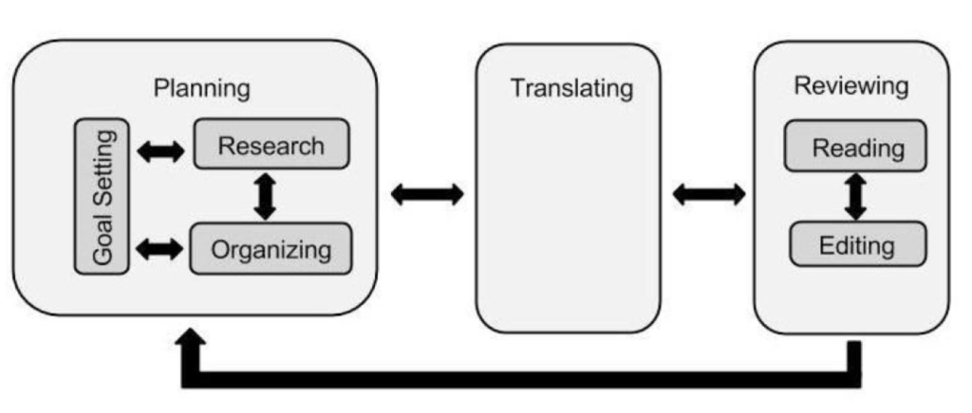
INTRODUCTION
In Flower & Hayes cognitive process theory of writing, writing is understood as a complex task that requires the coordination of three core cognitive processes: Planning, Translating, and Reviewing.
Source: https://learningaloud.com/blog/2024/03/19/ai-tech-tools-and-the-writing-process/
Flower, L., & Hayes, J. R. (1981). A cognitive process theory of writing. College Composition & Communication, 32(4), 365-387.

Slide 3
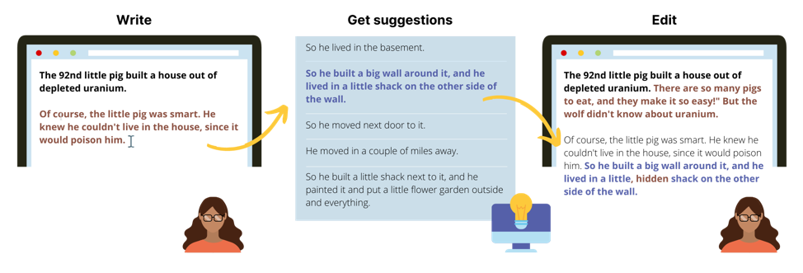
INTRODUCTION
With the popularity of Generative AI (GenAI), students can now easily use these tools to enhance their writing, known as GenAI-assisted writing.
Source: https://coauthor.stanford.edu/

Slide 4

INTRODUCTION
In GenAI-assisted writing, students can easily delegate core cognitive tasks (e.g., generating ideas (Planning) and turning them into sentences (Translating)) to GenAI while still producing high-quality essays.
whether students are engaging in meaningful cognitive processes during writing or
how much of the essay’s quality can be attributed to those processes.

Slide 5

INTRODUCTION
Additionally, previous research has demonstrated that Large Language Models (LLMs, a main subset of GenAI) can carry and amplify significant biases (e.g., gender, racial, and socioeconomic).
Linguistic Biases, such as the use of terms like "female nurse" or "male doctor," embedded in LLMs may lead to biased outputs, which could be incorporated into students’ work.

Slide 6
RESEARCH QUESTION
RQ: What writing behaviours contribute to the quality of written products in the setting of GenAI-assisted writing?

Slide 7
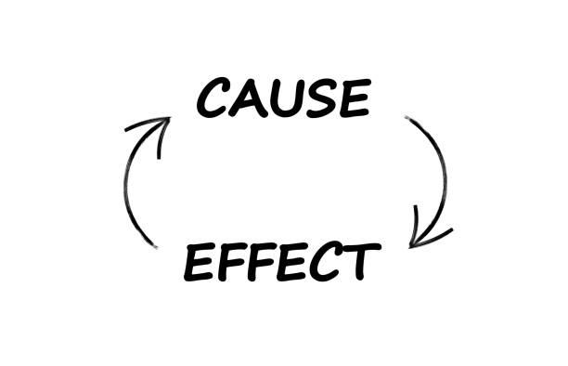
METHODOLOGY
To answer the RQ, we aimed to quantify the causal impact of GenAI-assisted writing behavioral patterns on essay quality metrics.
Randomized Controlled Trials (RCTs) => Gold Standard
Not feasible in our study
Causal Modeling, a statistical method designed to uncover and understand cause-and-effect relationships using observational data.

Slide 8
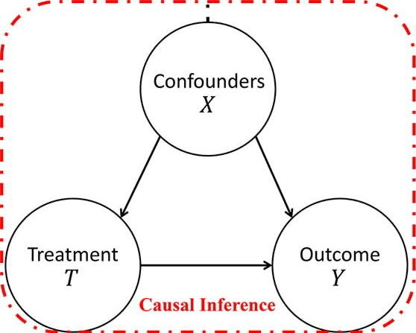
METHODOLOGY
The key goal of causal modelling is to establish the relationship between treatment and outcome while conditioning on confounders.
The confounders are variables that influence both the treatment and the outcome, potentially distorting the apparent effect of the treatment on the outcome.
Treatments refer to the variable or intervention that is being applied or manipulated to observe its effect on another variable.
The outcomes are the variables that researchers are interested in measuring to see if they are affected by the treatment.

Slide 9


METHODOLOGY
Our objective is to evaluate the effect of a treatment on an outcome.
We need Counterfactual Values !!!
Inherently Unobservable !!!
Factual
Comparing
Effect
Counterfactual

Slide 10
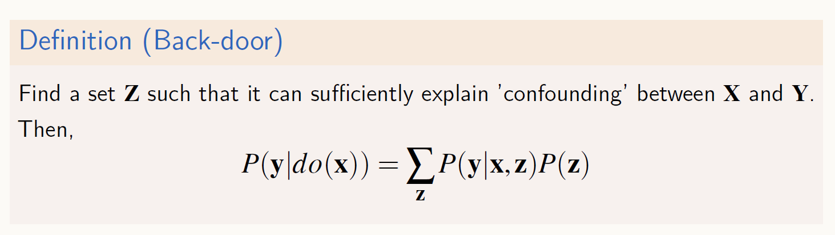
METHODOLOGY
Identification Techniques - Reduce causal estimands into statistical estimands (i.e., estimated from observed data).
Back-door criterion
Confounder Z
Treatment X
Outcome Y
Source: https://secundo.tistory.com/86

Slide 11
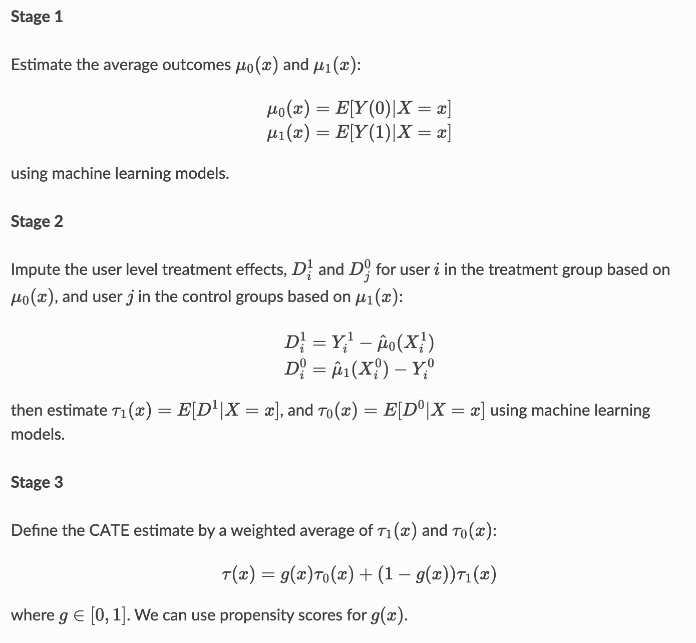
METHODOLOGY
Estimation Methods - X-Learner
It figures out how much a treatment helps each one by smartly guessing their missing outcome, learning from similar people, and combining the results to get a better estimate.
Künzel, Sören R., et al. "Metalearners for estimating heterogeneous treatment effects using machine learning." Proceedings of the national academy of sciences 116.10 (2019): 4156-4165.

Slide 12
METHODOLOGY
Estimation Metrics
ATE (Average Treatment Effect)
ITE (Individual Treatment Effect)
ATE gives the big picture (overall impact).
ITE is personalized (effect for each individual).
Refutation Tests
Random Common Cause (RCC)
Placebo Treatment Refuter (Placebo)
Data Subset Refuter (DSR)
To further investigate the extent to which different confounders impact ITE, we generated SHAP (SHapley Additive exPlanations) beeswarm plots to visualise the varying importance of confounders.

Slide 13



METHODOLOGY
In our prior study on GenAI-assisted writing, we identified distinct patterns of GenAI-assisted writing using a clustering approach. Based on this, we are interested in the following three behavioural patterns:
writers sought suggestions from GenAI but seldom accepted such GenAI-generated text for their writing;
writers who tended to blindly trust GenAI, i.e., they often sought suggestions from GenAI and accepted them as they were; and
writers who partly trusted GenAI, i.e., they often sought suggestions from GenAI and accepted them with modification.
Correspondingly, we defined three treatments in our study:
(T1) seek suggestions -> not accept;
(T2) seek suggestions -> accept without revision; and
(T3) seek suggestions -> accept and then revise.

Slide 14
METHODOLOGY
We measured the quality of essay products from four different perspectives, namely lexical sophistication, syntactic complexity, text cohesion, and linguistic bias, and used them as the outcome variables (i.e., Y1, Y2, Y3, and Y4) in the causal modelling process.
Lexical sophistication (Y1): Advanced Guiraud
Syntactic complexity (Y2): Mean Length of T-Unit (MLTU)
Text cohesion (Y3): Semantic Overlap
Linguistic Bias (Y4): Genbit Score

Slide 15
METHODOLOGY
Guided by previous studies, we studied the following five confounders (C1, C2, C3, C4, and C5), all of which might be important in GenAI-assisted writing.
Writing genre (C1)
A Writer’s language background (C2)
Writing topic (C3)
GPT temperature (C4) and frequency penalty (C5) settings.

Slide 16
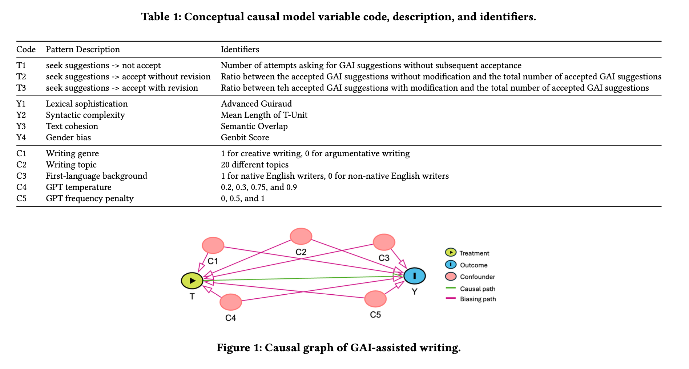
METHODOLOGY

Slide 17
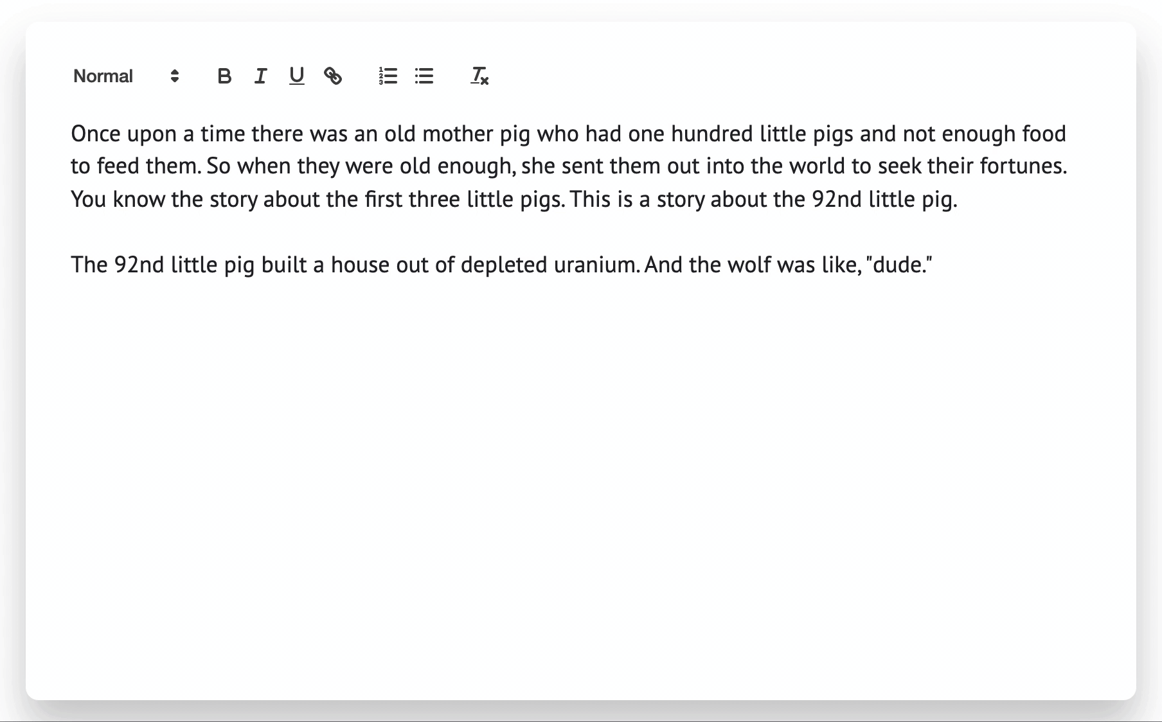
METHODOLOGY - DATASET
CoAuthor
Rich interaction between 63 writers and four instances of GPT-3.
1445 writing sessions in English.
830 creative writing, 615 argumentative writing
Writing topics - subreddit & The New York Times
Writers had the flexibility to accept, reject, or first accept and then modify these suggestions to better fit their writing.
Source: https://coauthor.stanford.edu/
Lee, M., Liang, P., & Yang, Q. (2022, April). Coauthor: Designing a human-ai collaborative writing dataset for exploring language model capabilities. In Proceedings of the 2022 CHI conference on human factors in computing systems (pp. 1-19).

Slide 18
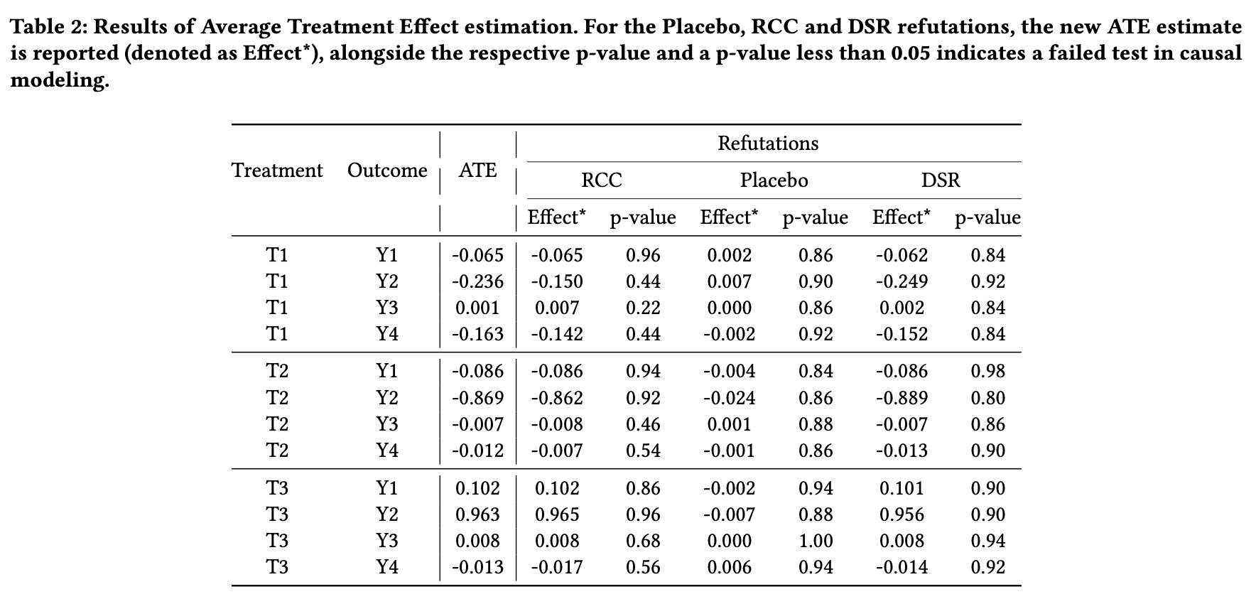
RESULTS
Writers who frequently rely on GenAI to write for them exhibit the poorest performance in terms of writing quality.
All the causal models for each treatment-outcome pair successfully passed the three refutation tests, with all p-values exceeding 0.05, indicating that our causal inference results are both robust and credible.
Writers who actively revise GenAI suggestions achieve the highest performance in writing quality, indicating that the process of critically engaging with and refining GenAI-generated suggestions enhances lexical sophistication, syntactic complexity, and text cohesion in the written work.

Slide 19
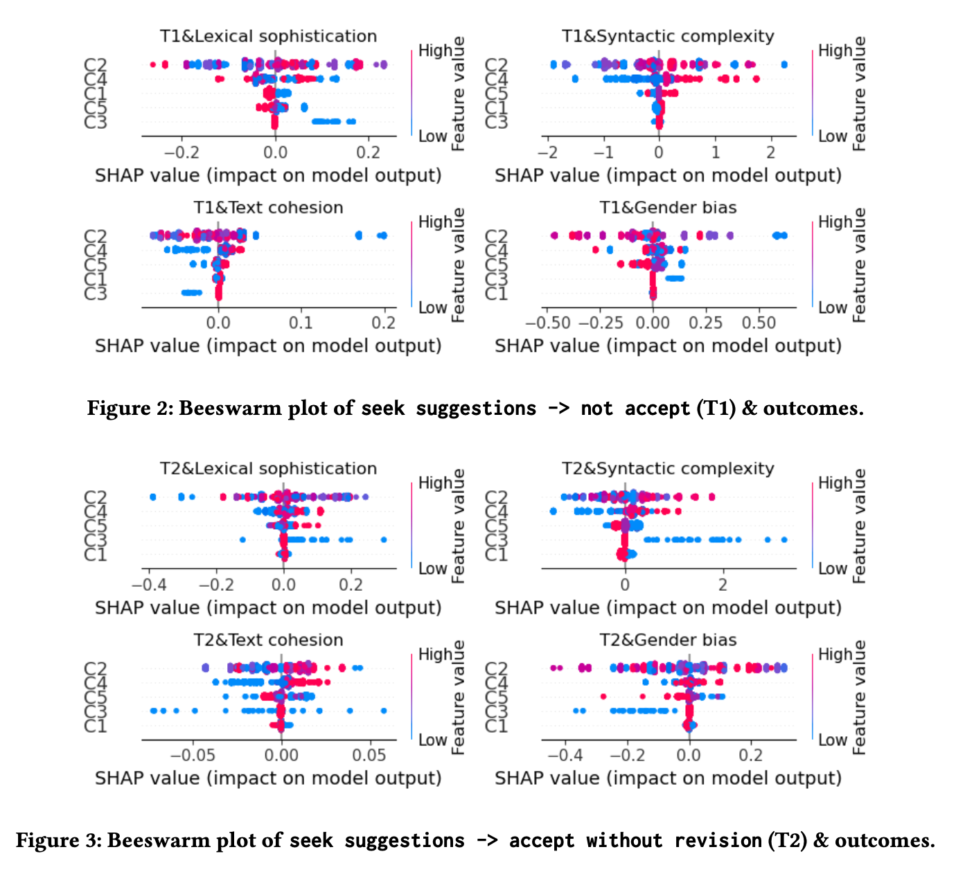
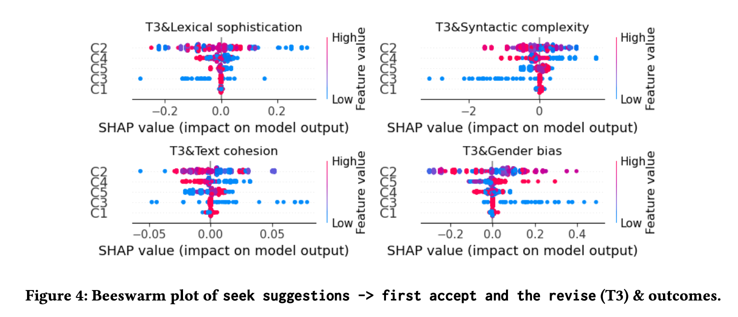
RESULTS

Slide 20
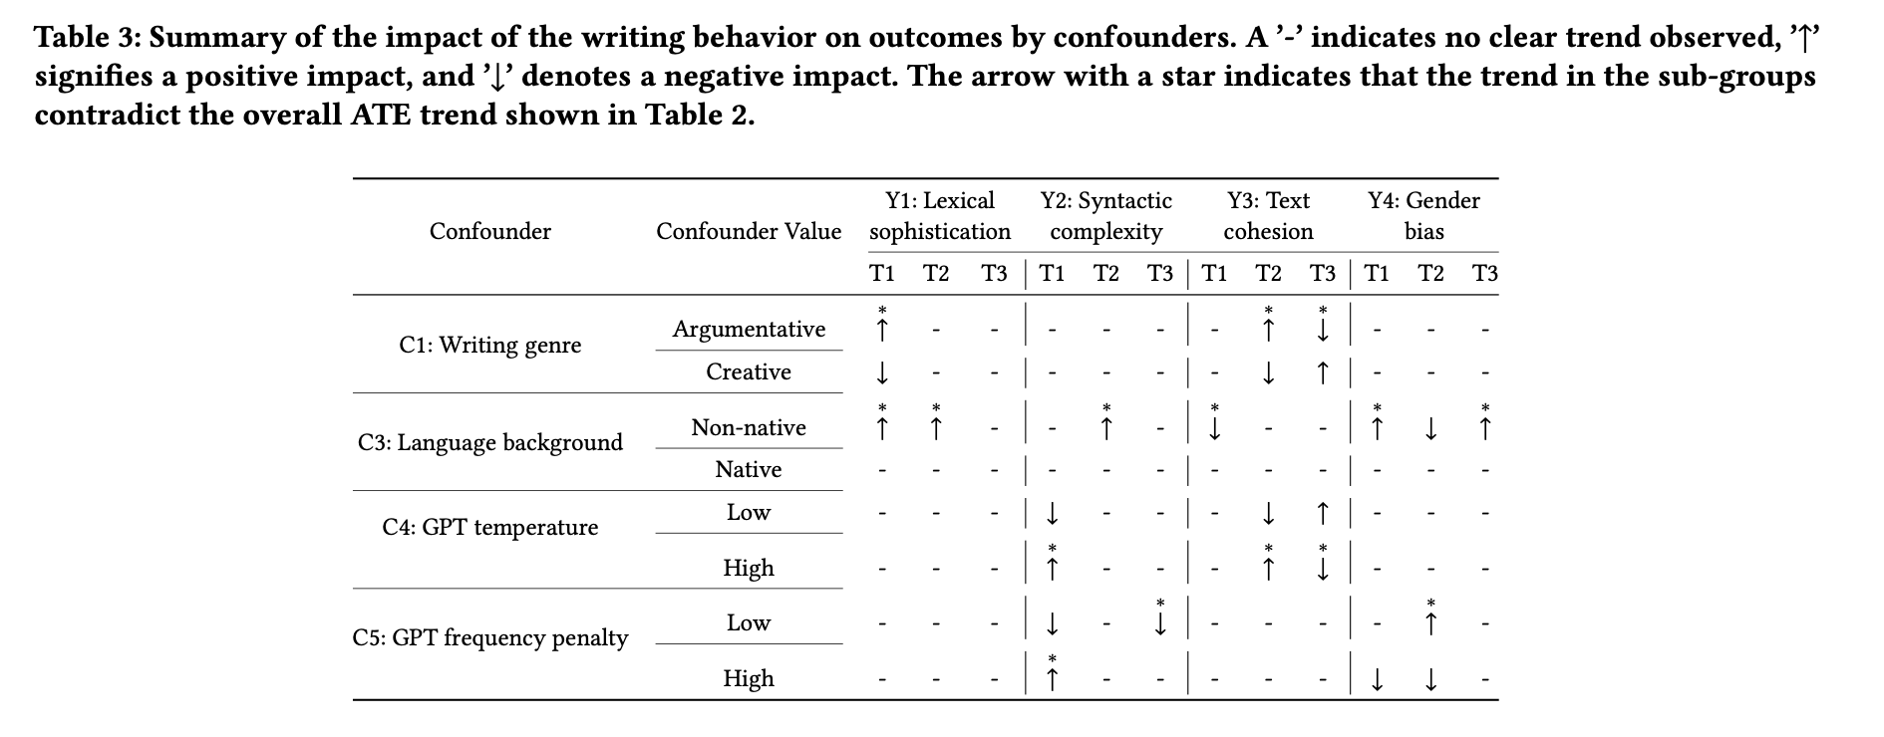
RESULTS
Non-native English writers who directly use GenAI-generated text (T2) tend to produce essays with lower gender bias compared to those written primarily on their own (T1) or those consisting of revised GenAI-generated text (T3).
Directly adopting GenAI-generated text without modification (T2) positively impacts syntactic complexity for non-native English writers.
Seeking GenAI suggestions without directly accepting them (T1) has a positive effect on lexical sophistication in argumentative writing, while the effect is negative in creative writing.
When GPT temperature is high, meaning the GenAI-generated text becomes more diverse and creative, text cohesion tends to benefit less from active revisions of GenAI suggestions.

Slide 21
KEY TAKEAWAYS
GenAI-assisted writing behaviours can influence the quality of written products, with the final product reflecting not only their writing abilities but also how they use GenAI.
Actively engage with GenAI-generated content by critically refining GenAI suggestions produce writing with more sophisticated vocabulary, complex sentence structures, and cohesive content.
When writing independently, human writers are likely to introduce linguistic bias into their text. By incorporating GenAI-generated text—whether through revision or direct use—writers can produce essays with reduced linguistic bias.
Some non-native writers and writers in high GPT temperature settings, who showed less meaningful learning by frequently accepting GAI suggestions without modification, still produced high-quality essays. This highlights that evaluating only the final written products in GenAI-assisted writing tasks is insufficient and may cause some students to miss valuable learning opportunities during the writing process.

Slide 22
LIMITATIONS
Our findings are based on the CoAuthor dataset, which may limit their generalizability to other writing contexts with different subjects or requirements.
Future Work: We aim to gather additional data from more diverse writing settings to further validate our results.
The limited availability of writer-related information, such as GenAI literacy, restricts the inclusion of relevant confounders.
Future Work: We plan to incorporate surveys or tests in future data collection efforts to better capture these factors.

Slide 23
THANK YOU FOR LISTENING!
Presenter email: kaixun.yang1@monash.edu

